Slide 1
VLSI Implementation of DENLMS Adaptive Filter for Biomedical Applications
Low-Power & High-Speed ECG Noise Removal Architecture
Authors
C. Venkatesan, T. Thamaraimanalan, R. Latha
Mohammad Ali Sakib
ID No : 220137
Reg.:1011979
Dept. of CSE
Pabna University of Science and Technology

Slide 2
Contents :
Core Problem and Context
Context
Challenge
Solution Needed
Problem Motivation
Non-stationary nature of ECG noise
Limitations of traditional FIR/IIR filters
Adaptive Filter Concept
What is an adaptive filter
Why adaptive filtering is required
Limitations of Existing LMS-Based Methods
LMS
ENLMS
DNLMS
Proposed DENLMS Adaptive Filter
Key idea
Delayed error concept
Advantages
Algorithm & VLSI Architecture
DENLMS weight update equation
Pipelined hardware architecture
Implementation & Design Flow
HDL design
Simulation
Synthesis & layout
Results & Performance Analysis
Error comparison
Power, area, and speed comparison
Key Findings
Why DENLMS is better
Suitability for wearable ECG devices
Conclusion
Question And Answer Part

Slide 3
The Core Problem & Context

Slide 4
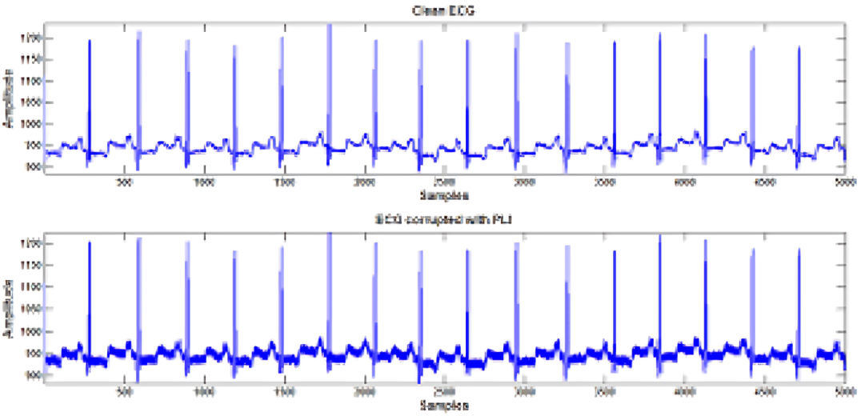
Context
In healthcare, clean Electrocardiogram (ECG) signals are vital for accurate diagnosis. However, these signals are often corrupted by noise during recording and transmission.

Slide 5
Challenge :
Traditional fixed filters (like FIR/IIR) struggle because ECG noise is non-stationary—its statistics change over time.
Here “non-stationary” means that the statistical properties of the ECG signal or its noise are not constant over time.

Slide 6
Solution Needed:
We require adaptive filters that can "learn" and adjust to changing noise in real-time.

Slide 7
PROBLEM MOTIVATION
Why This Work is Needed ?
“ECG signals change over time. Fixed filters cannot adapt. So adaptive filters are required, especially for wearable medical devices.”
ECG signals are non-stationary
Affected by:
White Gaussian noise
Channel noise
Traditional FIR / IIR filters fail
Need:
Adaptive filter
Low Power
High speed hardware

Slide 8
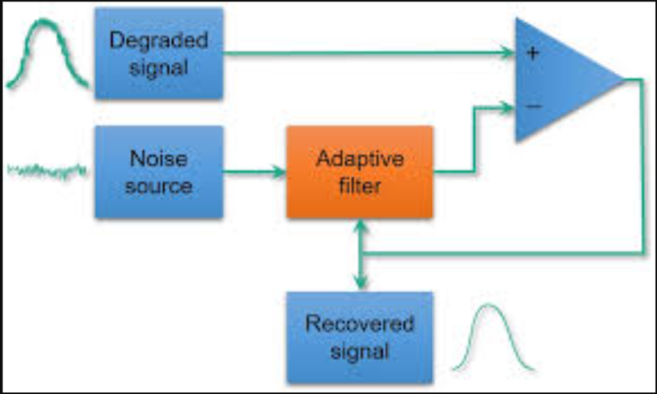
WHAT IS AN ADAPTIVE FILTER ?
Adaptive Filter Concept :
Self-adjusting digital filter
Minimizes error signal
Updates coefficients automatically
Working Diagram of Adaptive Filter :
Input → Filter → Output
↑
Error

Slide 9
LIMITATION OF EXISTING LMS (Least Mean Square ) :
Problems
Long critical path
High latency
More power consumption
ENLMS & DNLMS still inefficient

Slide 10
PROPOSED SOLUTION
DENLMS Adaptive Filter
( Delayed Error Normalized LMS )

Slide 11
Key Idea
Introduce delay element in error path
Use pipelined architecture
Reduce critical path delay
Advantages :
Faster operation
Lower power
Suitable for biomedical VLSI

Slide 12
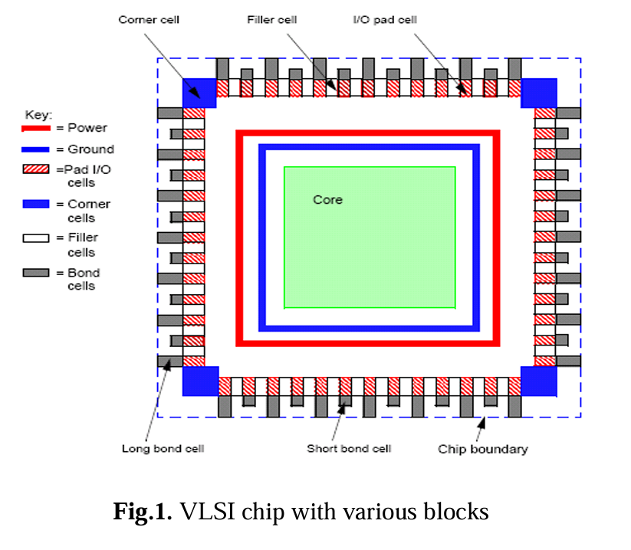
VLSI CHIP Architecture :
Standard cells (NAND, NOR, Inverters)
Synthesized using TSMC 130nm
ASIC design flow
“This shows the physical realization of the adaptive filter using standard VLSI cells.”

Slide 13
DENLMS Algorithm & Implementation Details

Slide 14
Conventional LMS Weight Update
Normalized LMS (ENLMS)
w(n+1)=w(n)+μe(n)x(n)
Problem:
Long critical path
Slow hardware execution
w(n+1)=w(n)+∥x(n)∥2μ​e(n)x(n)
Improvement: Stability
Still problem: High power & delay

Slide 15
Proposed DENLMS Weight Update
w(n+1)=w(n)+μe(n−m)x(n−m)
Key Modification
Error is delayed by m samples
Enables pipelining
“Here we modify the LMS algorithm by introducing a delay in the error feedback path”.

Slide 16
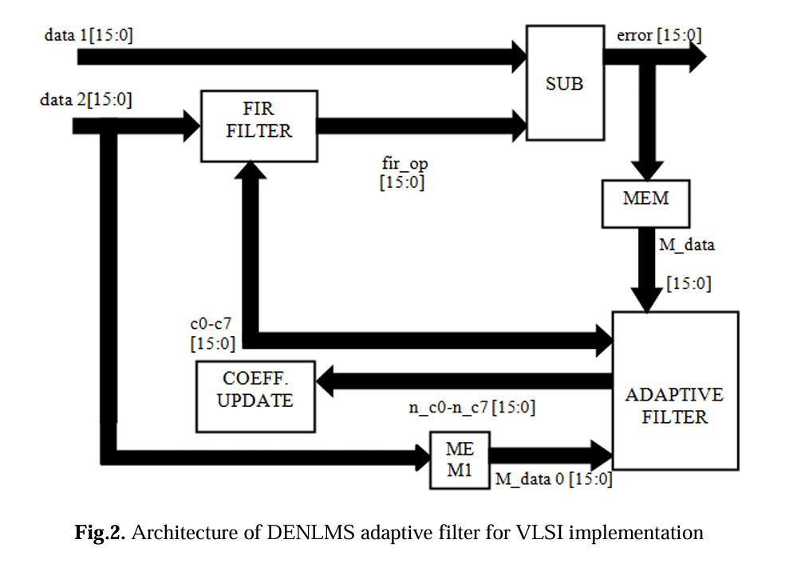
Why Delay Helps?
Here delay means DENLMS
Breaks feedback loop
Reduces critical path
Allows parallel execution
Improves clock speed
Proposed Architecture
16-bit pipeline
FIR filter
SUB block for error
Adaptive coefficient update
NOTE : “This is the core contribution of the paper.”

Slide 17
HDL & IMPLEMENTATION FLOW
RTL Design
(Verilog/VHDL)
Tools Used
Verilog HDL
ModelSim (Simulation)
Xilinx ISE (FPGA)
Synopss DC (ASIC)
Simulation
(Functional)
Synthesis
(Gate Level)
Target FPGA
Virtex-5 XC5LVX330
Layout
(Physical)
VLSI Design Flow Diagram

Slide 18
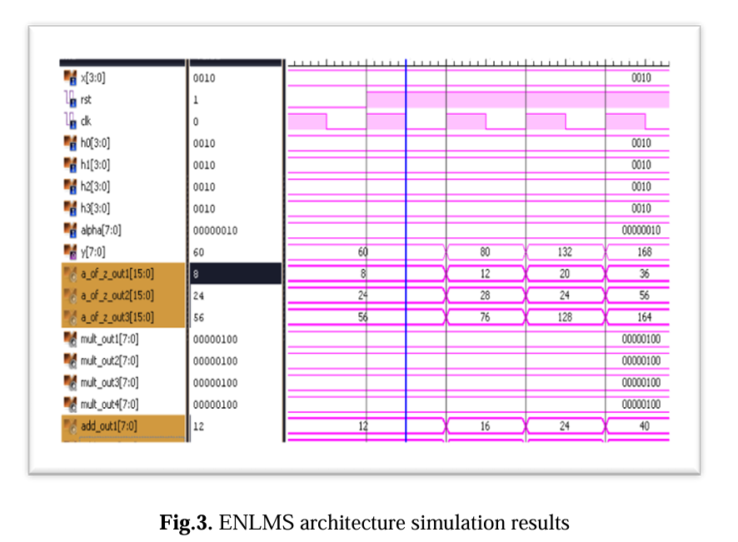
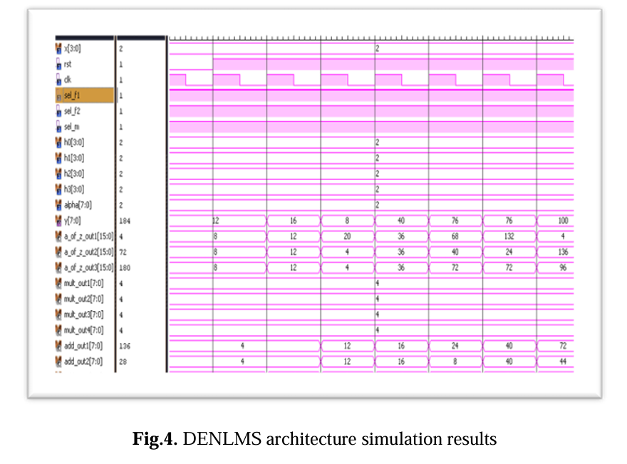
SIMULATION RESULTS ☹
ENLMS vs DENLMS
DENLMS error is much lower
Stable output with 16-bit precision
NOTE : “Lower error means better ECG noise removal.”

Slide 19
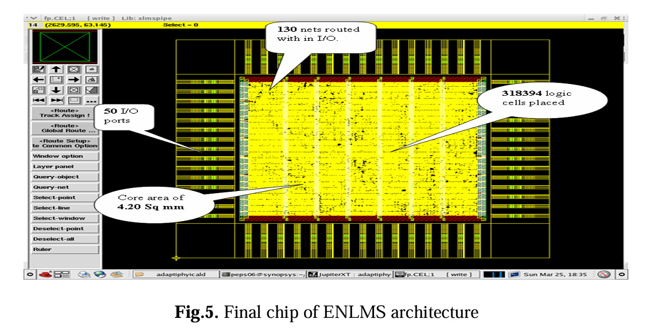
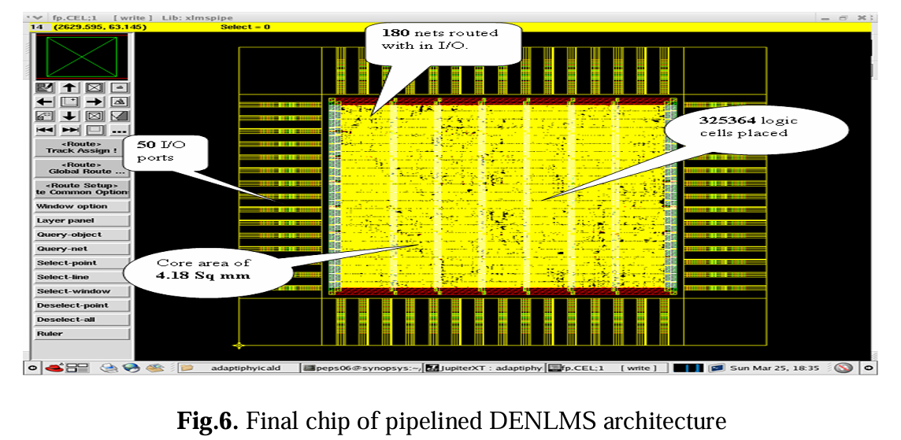
FINAL CHIP LAYOUT
Observation
Area slightly increased
Performance greatly improved

Slide 20
PERFORMANCE COMPARISON :
Parameter | ENLMS | DNLMS | Proposed DENLMS | Improvement by DENLMS
Total Dynamic Power | 84 mW | 71 mW | 64 mW | 23.8% lower than ENLMS
Cell Leakage Power | 176 µW | 159 µW | 124 µW | 29.5% lower than ENLMS
Total Area (Logic Cells) | ~31.5 K | ~328.6 K | ~335.5 K | 20.4% increase
Slack (Timing Margin) | 0.27 | 0.31 | 0.19 | Lower slack, enables faster clock

Slide 21
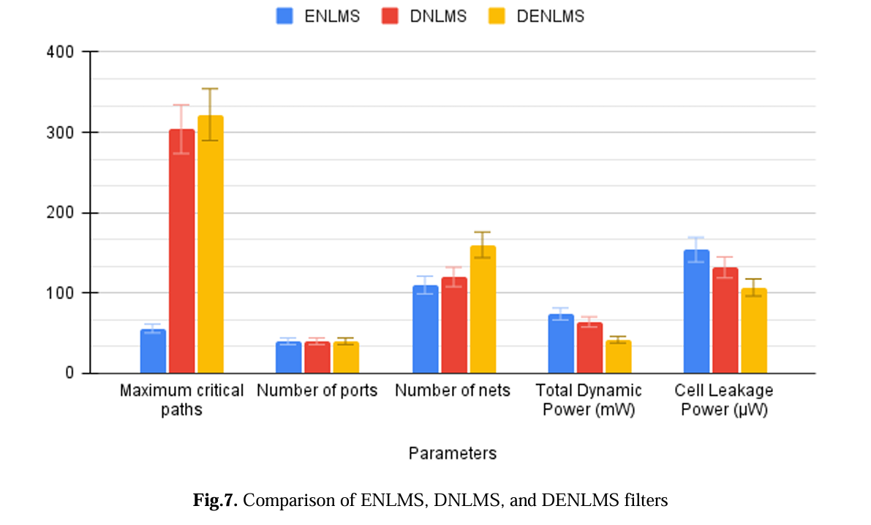
“This is the bar diagram of the previous slide. Its give us a beautiful visualization of the comparison between ENLMS,DNLMS,DENLMS”.

Slide 22
KEY RESULTS :
Why DENLMS is Better
Low dynamic power
Low leakage power
High speed
ECG suitable
Wearable-friendly

Slide 23
Some Short Note of This Paper :
Note-1 : DENLMS outperforms ENLMS & DNLMS
Note-3 : Ideal for biomedical ECG devices
Note-2 : Best trade-off between:
Power
Speed
Area

Slide 24
CONCLUSION :
“This work proves that smart pipelined adaptive filters can save power without sacrificing performance.”

Slide 25
THANK YOU

Slide 26
Any Question ?

